Slide 1


Welcome To Nexthikes IT Solutions
Project 2 : Data Harmonization and
Insights Extraction
By: Priya Tripathi

Slide 2
INTRODUCTION
Data harmonization
This process can help organizations:
Improve data quality: By addressing discrepancies in data types, formats, structures, and semantics
Enable better analysis: By making it easier to analyze data across the organization
Support decision-making: By providing a unified view of data
Improve strategic planning: By turning raw data into a source of business intelligence

Slide 3
Project Overview
The task at hand involves unifying and cleaning multiple datasets to create a consolidated resource that
can be used for analysis and modeling. Your primary objectives will be to:
Data Integration and Unification:
Merge disparate datasets, ensuring that all relevant data points from
different sources are captured accurately. Resolve any discrepancies in
data formats, structures, or naming conventions to ensure consistency across the datasets.
Data Cleaning and Wrangling:
Address missing, erroneous, or outlier data using appropriate techniques such as
imputation or removal. Standardize data values, convert categorical variables,
and handle any other data irregularities to ensure that the dataset is ready for analysis.
Perform necessary transformations and feature engineering to enhance the
dataset's quality and usability.

Slide 4

Analysis and Insights:
Conduct exploratory data analysis (EDA) to identify trends, patterns,
and correlations within the data. Derive meaningful insights and observations
that could inform further modeling or business decisions.
Deliverables:
Cleaned and Integrated Dataset: A final dataset that combines all sources,
free from errors and inconsistencies, ready for analysis or modeling.
Analysis Report: A document summarizing key findings from the EDA,
including trends, anomalies, and any other insights drawn from the data.

Slide 5

Jupyter Notebook: A detailed notebook with the code for data cleaning, transformation, analysis, and visualizations. It will also include visual aids like charts and graphs to support findings.
PowerPoint Presentation: A concise and visually appealing summary of the project, presenting key insights, outcomes, and recommendations to stakeholders.
Throughout this process, you’ll need to apply a range of data wrangling techniques,
including merging datasets, dealing with missing or inconsistent data, and transforming variables to create a dataset suitable for robust analysis.

Slide 6
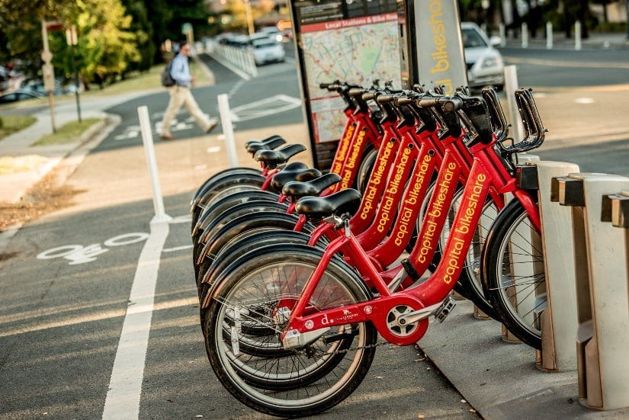
Dataset Exploration
Records daily bike/ cycle rentals with details on date,
season, holiday, working day, and weather conditions.
Provides information about temperature, humidity,
and wind speed. Includes data on the number of casual
and registered user rentals.

Slide 7
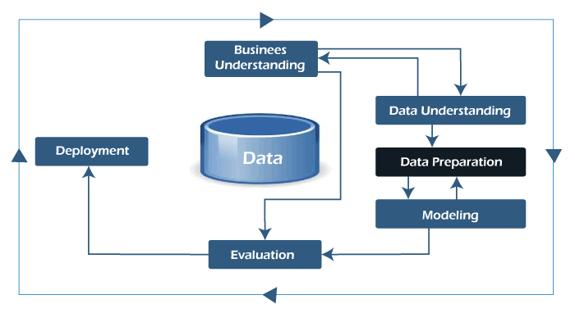
Data Wrangling:
Merging and Integration
Merge Dataset 1 and Dataset 2 using common keys like date,
season, or weather. The merge operation should produce a combined dataset that
retains all relevant information from both sources.
The final deliverables include a combined dataset with clean data,
an analysis report with observations and insights, a comprehensive Jupyter notebook with
code and visualizations, and a concise PowerPoint presentation.

Slide 8
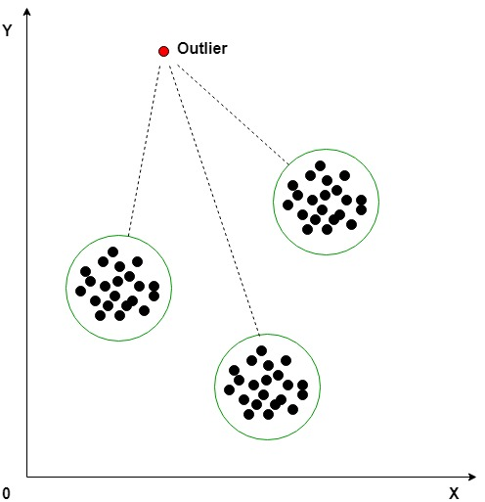
Data Wrangling:
Outlier Detection and Handling
Utilize statistical methods like boxplots or z-scores to detect outliers in the merged dataset. Outliers may indicate data errors or unusual events.
Apply outlier handling techniques like capping or removing outliers. Capping involves replacing extreme values with a predefined threshold. Removing outliers might be necessary if they significantly impact the analysis.

Slide 9
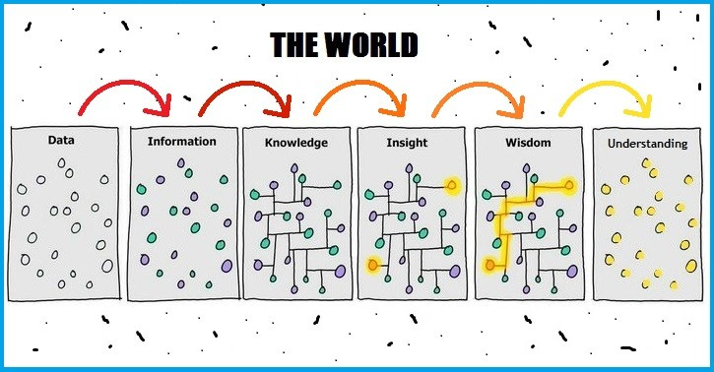
Data Analysis:
Insights Extraction
Analyze the distribution of numerical columns in the combined dataset.
Identify and correct skewness using appropriate transformations if necessary.
Calculate the correlation between different attributes to identify relationships.
Visualize correlations using heatmaps or scatter plots to understand the strength and
direction of dependencies. Examine the data for trends or patterns in
bike rental usage over time. Use visualizations like line plots or bar charts to highlight
any seasonal or day-of-the-week effects.

Slide 10
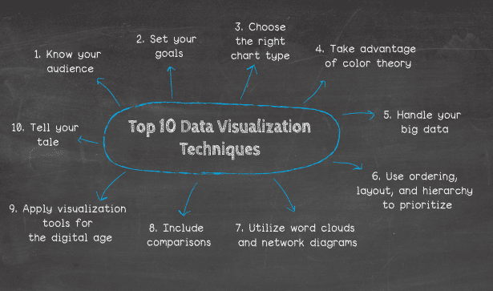
Visualization Techniques
Visualize the distribution of numerical data, identifying potential outliers and the spread of values.
Explore the frequency distribution of variables, understanding their shape and central tendencies.
Analyze the relationship between two variables, revealing linear or non-linear patterns.
Visualize the correlation matrix, highlighting strong positive or negative
correlations between attributes.

Slide 11
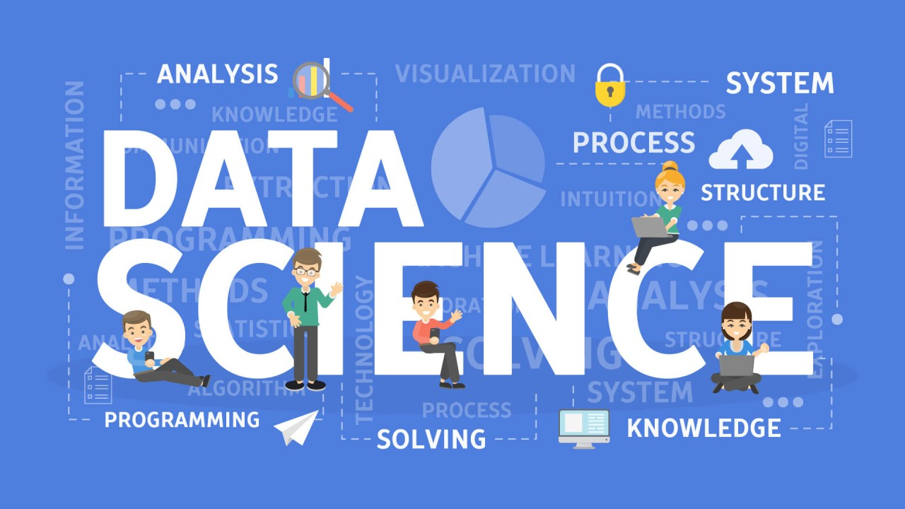
Key Takeaways and Next Steps
Investing time in cleaning and harmonizing datasets is essential for
accurate analysis and modeling. Understanding the characteristics of
your data is crucial for making informed decisions about cleaning and analysis.
Visualizing data helps reveal patterns, trends and insights that might be missed in raw data.

Slide 12

CONCLUSION!
In conclusion, the data harmonization process has successfully unified and cleaned the datasets,
ensuring consistency and reliability. Key insights were extracted through analysis,
revealing valuable trends and correlations. This provides a solid foundation for
informed decision-making and future modeling, driving data-driven strategies moving forward.

Slide 13

Do you have any questions?

